Slide 1
RPA Project Playbook - April 2020
Complete guide for RPA projects on the global platform

Slide 2
Part I: Platform and Services Overview

Slide 3
About RPA
Basics of Robotic Process Automation

Slide 4

Robotic Process Automation Definition
Robotic Process Automation is the automation of repetitive, rule-based, manual processes by using software ‘robots’ that ‘mimic’ the actions a human would perform on a machine. The robots can perform at scale to create a ‘virtual workforce’.

Slide 5
Benefits of RPA
Velocity - Increase process speed/cycle time. Improved SLAs and customer satisfaction.
Quality - Achieve 100% accuracy. Remove human error, incidents, and rework.
Compliance – Robots follow rules, every time! Plus, compliance alerts and full audit trails.
Productivity - Reduce time spent on manual tasks. Free up your workforce for high-value work.

Slide 6
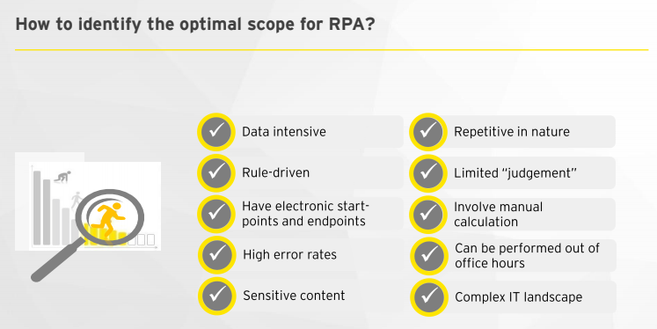

Slide 7
What is RPA? - Illustrative Example
Prepare word file with data
E-mail
Email with success message
Email with error information
Human
Robot
Monitor mailbox
Read word file, validate it
Prepare screenshot with error
Roche mailbox
Open new email and read attachment
Event was created successfully
MS Word
Log in to the web application and create an event based on data in word file
Is there an attachment correct?
yes
no
Send response informing that there is an incorrect attachment
Source: 20180205 - RGITSC RPA generic presentation
Notes:
Example use case from GIS

Slide 8
Platform Capabilities
What are the UiPath platform components?

Slide 9
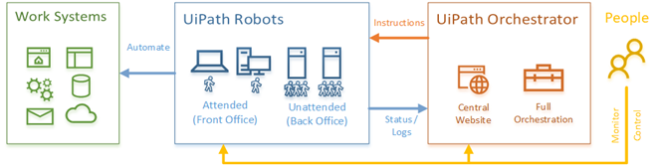
UiPath RPA Solution Overview

Slide 10
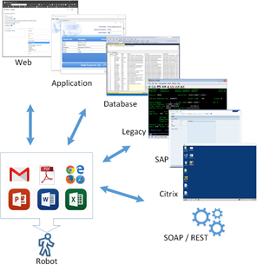
UiPath Robots
There are two types of robots:
Attended - Run on your desktop and help to partially automate your daily work. Run them when you want. They run on your behalf.
Unattended - Run on a remote server and fully automate a process by watching a queue of work items or following a fixed schedule. They have a unique identity (generic robot “RX” account).

Slide 11
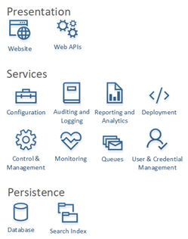
UiPath Orchestrator
UiPath Orchestrator is a central website that allows to track and control all of your robots from one location no matter where they are deployed.

Slide 12
Your UiPath
What you get when using the global UiPath platform

Slide 13
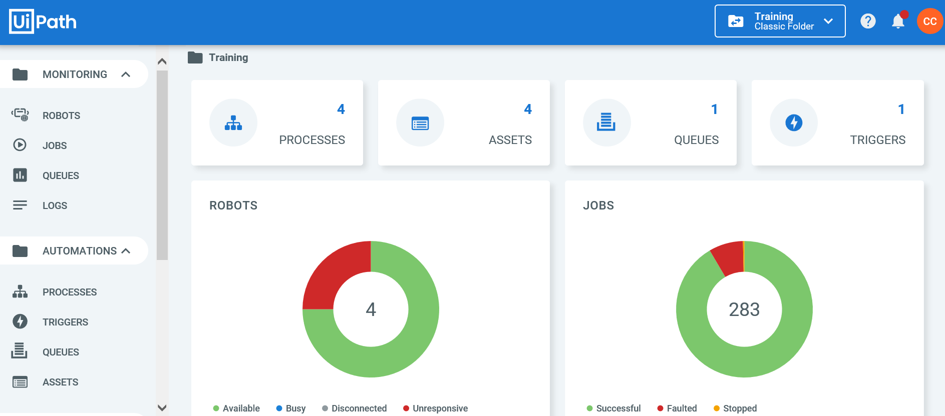
Your Orchestration
Your team’s Folder (Domain)
Resources unique to your Folder
Each application (or group of related applications) will have a private view or “Folder” within UiPath Orchestrator. Within your Folder (also called a “Domain”), you can control and monitor all of your Robots, Users, Schedules, Transaction Queues, and more. Only members of your Folder can view and manage these items.

Slide 14
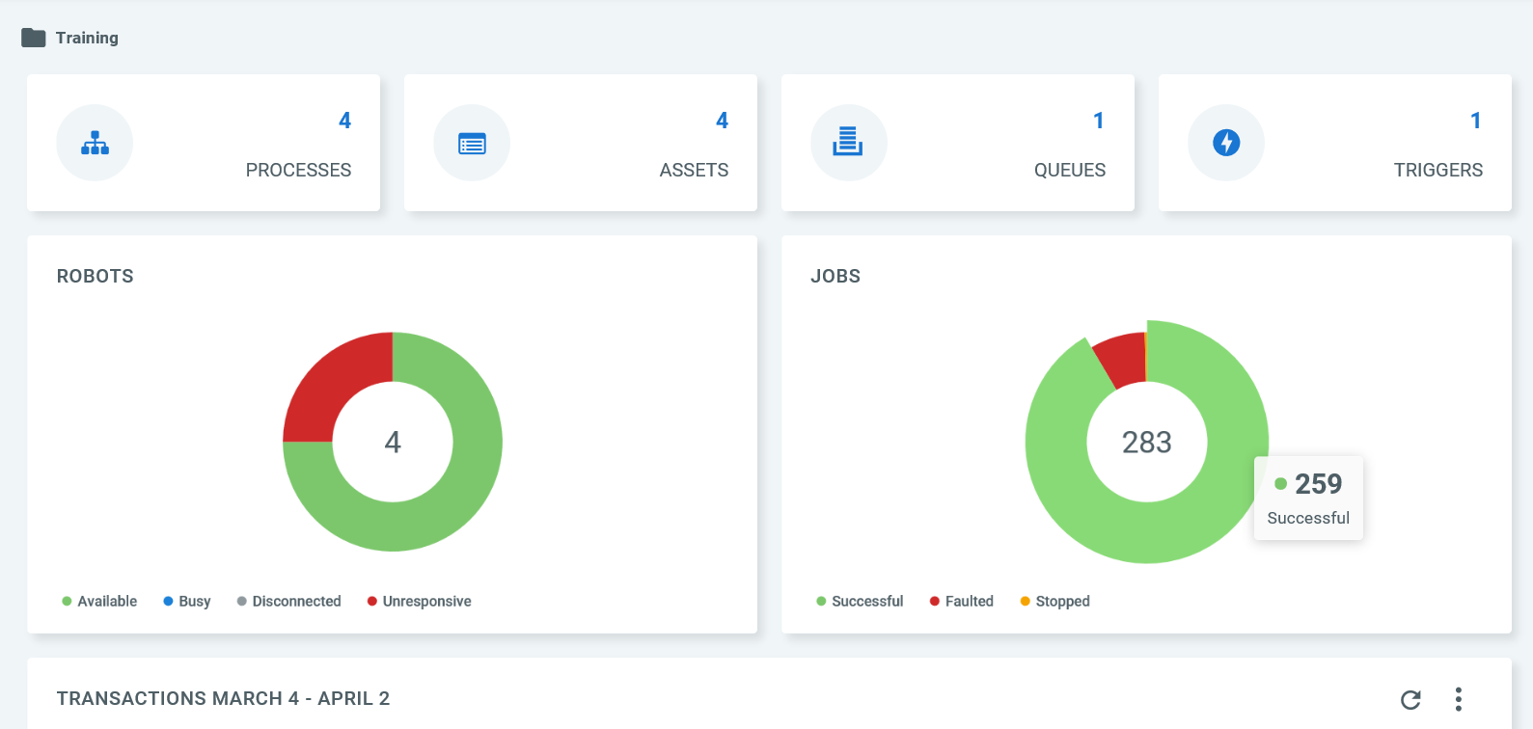
Dashboard
The dashboard gives you some quick reports and metrics about your overall robot and job health. You can further drill down into the details by clicking the report or navigating to the other screens within Orchestrator.

Slide 15
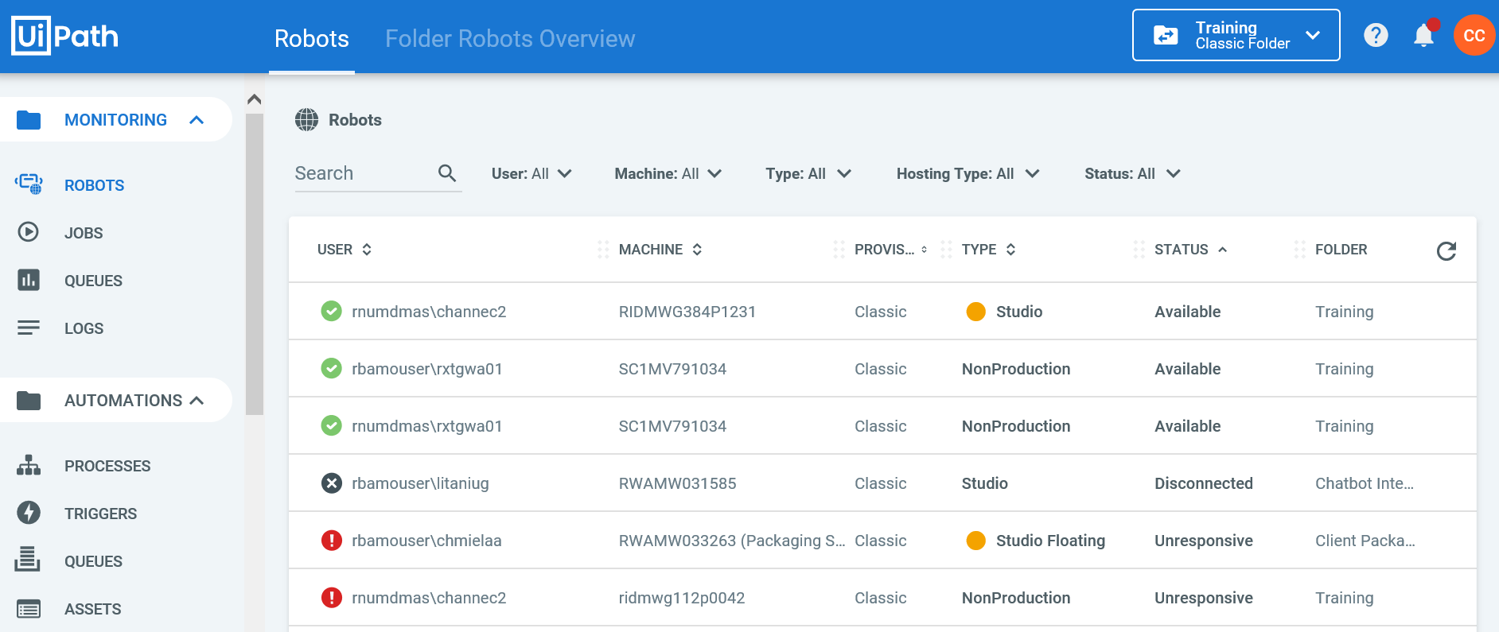
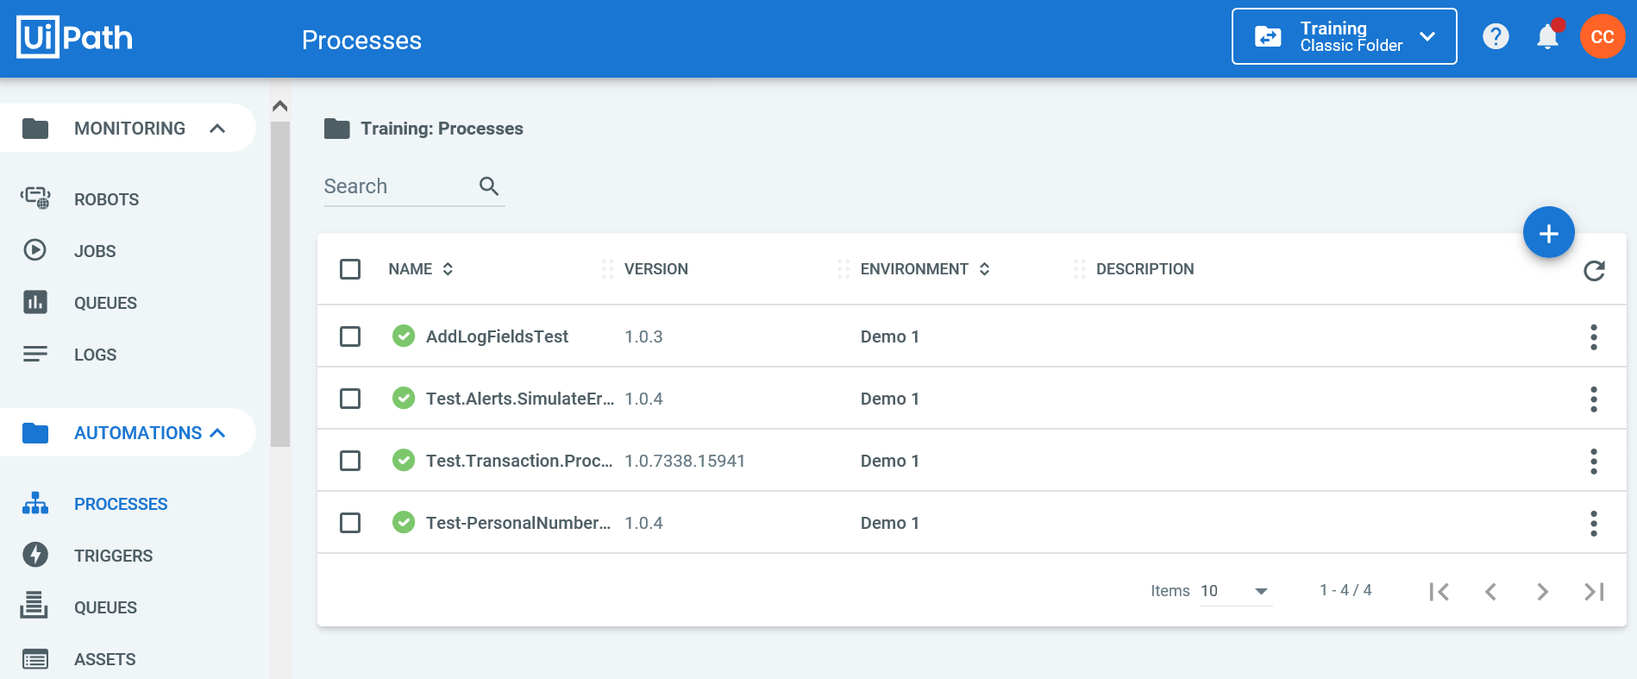
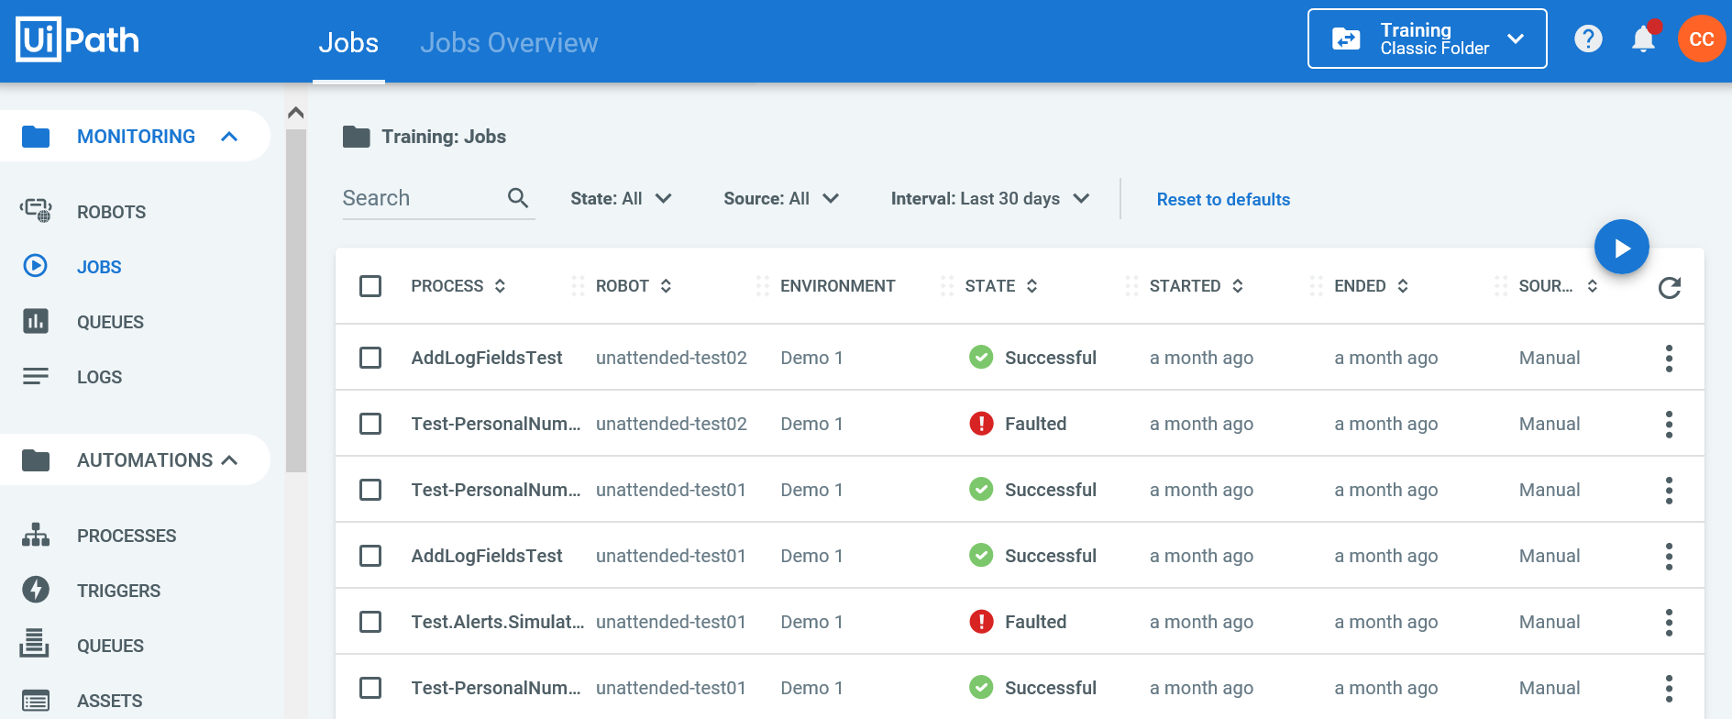
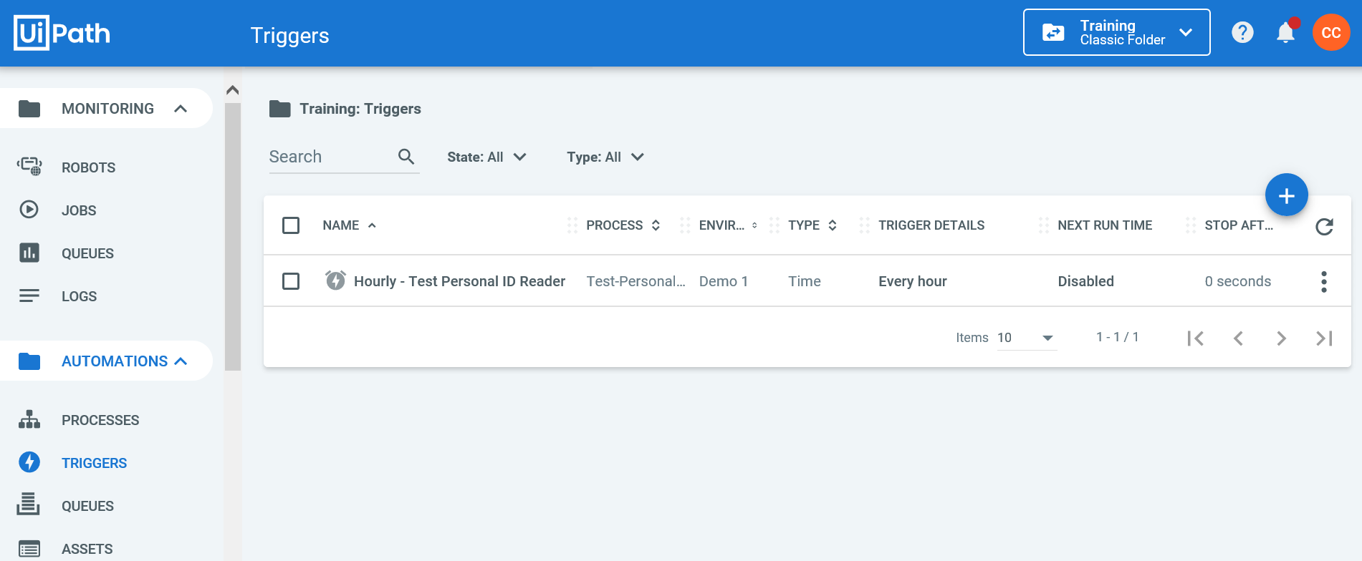
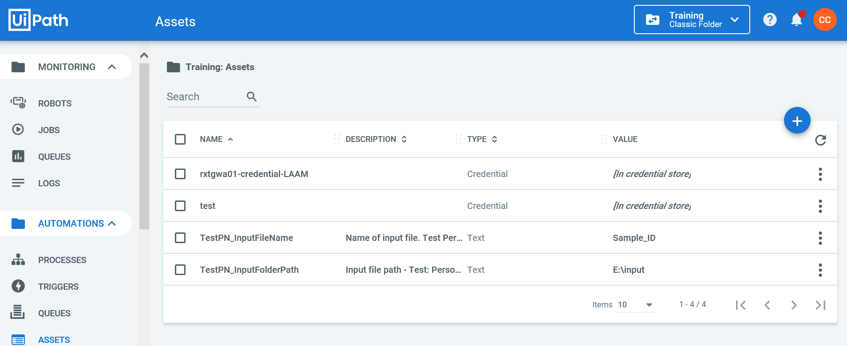
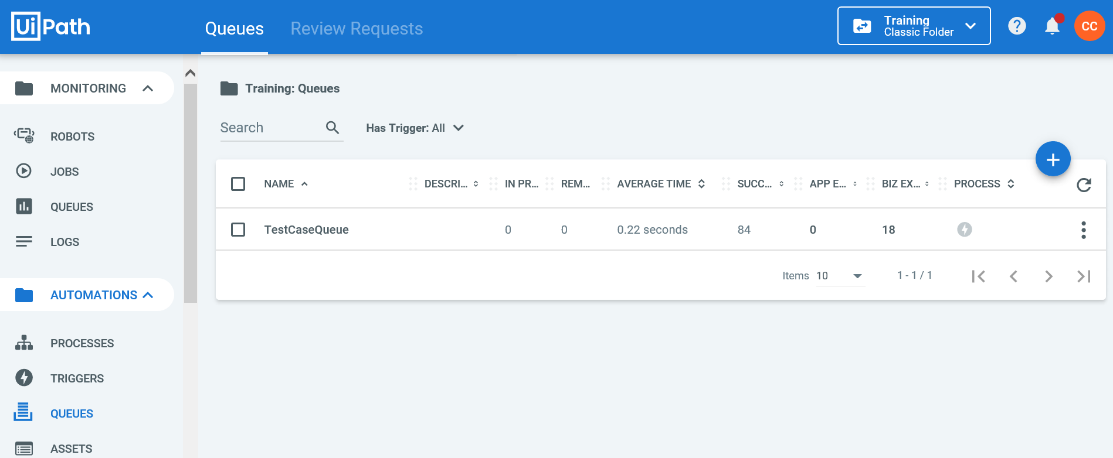
UiPath Orchestrator Screens
ROBOTS
PROCESSES
JOBS
View and manage your robots, their status, and their transaction logs
View the processes that your robots can execute
Check status of running and historical jobs and view their transaction logs
Triggers
ASSETS
QUEUES
Configure recurring schedules or event-based execution of jobs
Maintain global variables that can be used by all of your robots
Use transaction queues to give your robots work
Additionally, you can access your user profile screen and view audit logs of human interactions within Orchestrator.

Slide 16
UiPath Orchestrator Roles
Access to your Unit is governed by a collection of roles which allow each user to perform a specific function (or group of functions). Below are a list of the roles a user can have within a Unit.
Business Domain Owner (Process Owner) - One per domain. Owns and oversees the automations within a domain (folder) and is ultimately accountable for impacted process. Approves (or delegates approval of) access requests and automation deployments
Business Application Owner / Process SME - optional role. The subject matter expert of one or more specific automations. May accept delegation of some duties from business domain owner
Business Credential Owner - A business credential owner requests, owns, and maintains the generic credentials used by robots to access business systems
Business Viewer - A business viewer is any line-of-business process worker who has a need to monitor the progress of the robots
Technical Domain Owner / System Owner - One per domain. Manages the technical aspects of the robots and automations within a domain and coordinates releases of new or enhanced automation deployments
Technical Application Owner - optional role. Accountable for the technical ownership and lifecycle of one or more specific automations. May accept delegation of some duties from the technical domain owner
Robot Owner - The robot owner is primarily accountable for the technical ownership and lifecycle of a UiPath robot and owns/maintains the primary generic credential used by any unattended robot to login to its hosting back-office server
Robot Operator - The robot operator performs the daily scheduling, controlling, and monitoring activities of the robots within a domain
Developer - Qualified IT professional who develops and enhances automation applications. Has direct deployment capabilities in development environments.

Slide 17
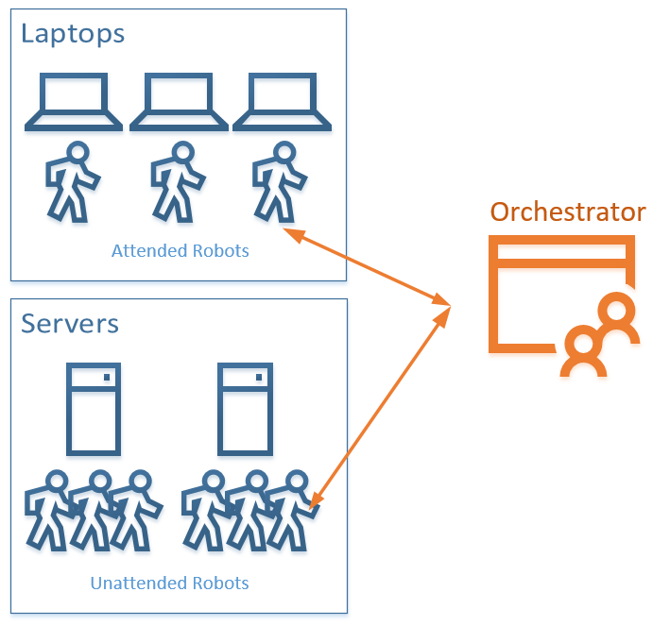
Your robots
You will also have one or more robots dedicated to your Unit and connected to Orchestrator.
Robots can be deployed directly onto you and colleagues’ laptops as Attended Robots.
Additionally, you can be provided with group of back-office servers, where each server can run one or more Unattended Robots.
The actual situation will vary based on your unique use-case.

Slide 18
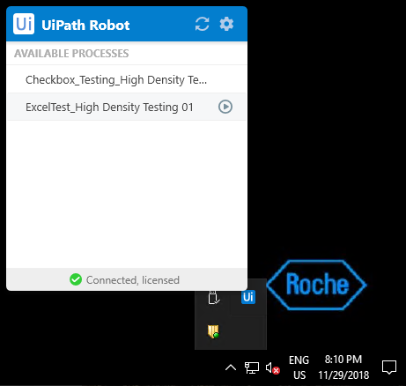
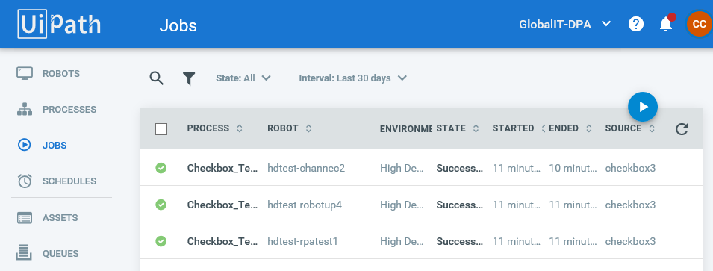
Controlling Your Robots
Attended Robots
Unattended Robots
Attended robots can be controlled from your system tray. Here you can launch jobs directly from your laptop.
Unattended robots can only be controlled from UiPath Orchestrator using Jobs, Schedules, and/or Queues.
Note that all robots can be monitored in UiPath Orchestrator!

Slide 19
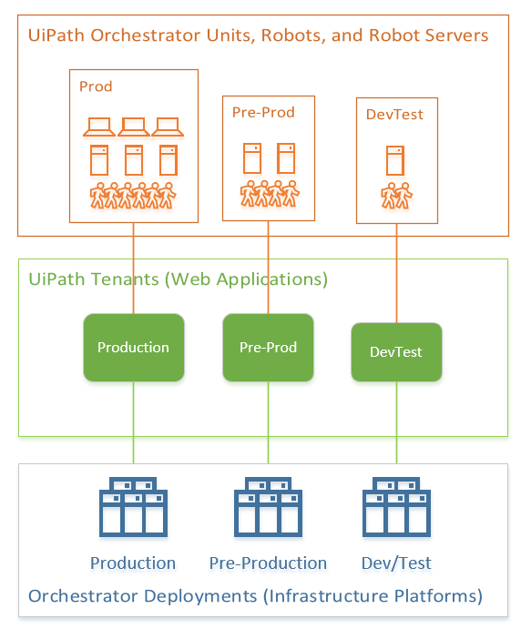
Deployment Environments
Finally, in order to support your development, testing, deployment, and change management process, your Unit and its robots can be duplicated in up to four different managed environments.
Dev/Test - Development, unit-testing, System acceptance testing, and PoCs
Pre-Prod - User acceptance testing and training
Prod - Production environment

Slide 20
Platform Governance and Limitations
Important policies and best practices for RPA projects

Slide 21
IT Quality and Security Requirements
Specific to your application
System Risk Assessments (SRA) are required for all RPA projects and POC’s and need to be initiated before beginning any development.
A Data Classification Report (DCR) may be required if your robot(s) will process sensitive data. This will be determined as an output of the SRA. Your IT Quality rep will guide you on this during the SRA review process.
IT Security Exceptions may also be raised if you have a business need to deviate from established processes and governance. This is commonly raised when a DCR is required, but not practical due to timelines.
You must submit your application to the German Workers Council if any German users are involved.
What? How?
You will need to initiate your SRA in iRAAM, our Roche Information Risk Assessment and Mitigation System.
DCRs also need to be initiated in iRAAM.
Please raise these via the Security Exception Management Portal (SEMP).
Please complete either the German or English version of the questionnaire and submit to Martina Gernold-Kunzler (FAZ...6164). The final version needs to be submitted in German.

Slide 22
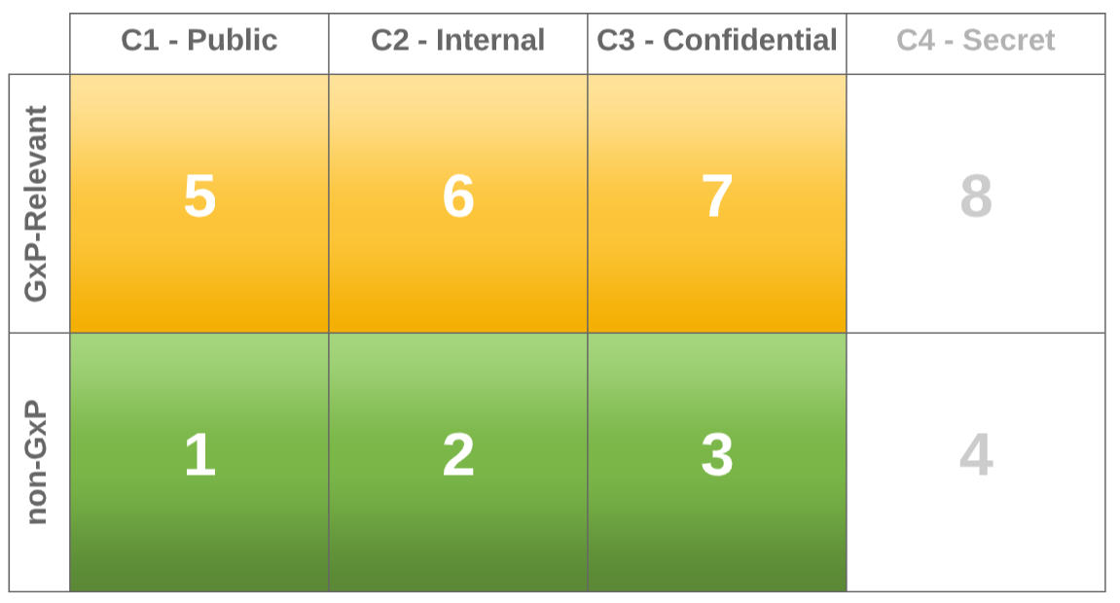
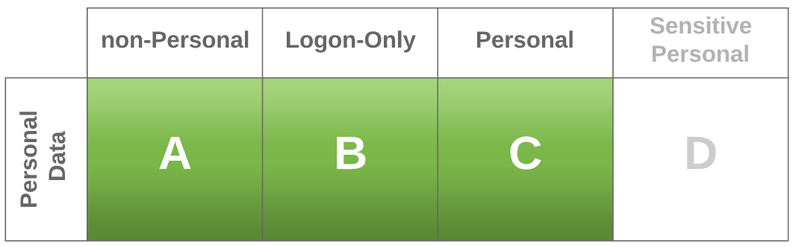
UiPath Platform Intended Use - IMPORTANT!
The intended use of the Global UiPath Service and platform is to enable its robots to safely process data up to and including the values defined in the following two dimensions:
Confidentiality Level: C3 - Confidential
Privacy Level: Personal (but non-sensitive)
Explicitly excluded from coverage by the platform are the following: Secret Data (C4) and Sensitive Personal Data.
Each automation domain or applications with requirements outside this platform intended use profile, must engage independently with IT Quality to assess risk and identify needs for further assessments by IT Security/other groups in order to identify required actions and gain necessary approvals.
Important Note: A platform penetration test will be conducted from 27-Jan-2020 to 31-Jan-2020. Until all findings from this penetration test being classified as either "critical" or "major" are addressed, no onboarding of projects with GxP data may occur the platform, and projects with Confidential Data (C3) must continue to undergo individual assessments by IT security (e.g. DCR or Security Exception processes).

Slide 23
Policy of PoCs
Proof of Concepts (PoCs) provide a popular way to quickly test out a scenario in order to assess feasibility of a technology and learn more about its potential. PoCs are supported in Roche RPA development as long as they align with the following understandings and constraints:
A PoC is neither a prototype nor beta software. It’s a feasibility check on the technology.
It usually implements only one small piece of a desired outcome, and typically follows only a “happy path” of a process in which no errors or exceptions are expected
It is not intended for use by end users
Nor is it an acceptable production release candidate
NEVER run a PoC application against Roche productive environments!
In certain scenarios a limited pulling of data may be allowed if approved by IT Security and relevant system owners
However, a PoC should never push data to any productive systems
System risk assessment (SRA) is still required
According to Roche IT Quality and Security Policies, you should still submit an SRA even for a PoC
Many non-productive systems at Roche contain copies of potentially sensitive production data. An SRA is needed to appropriately assess this risk

Slide 24
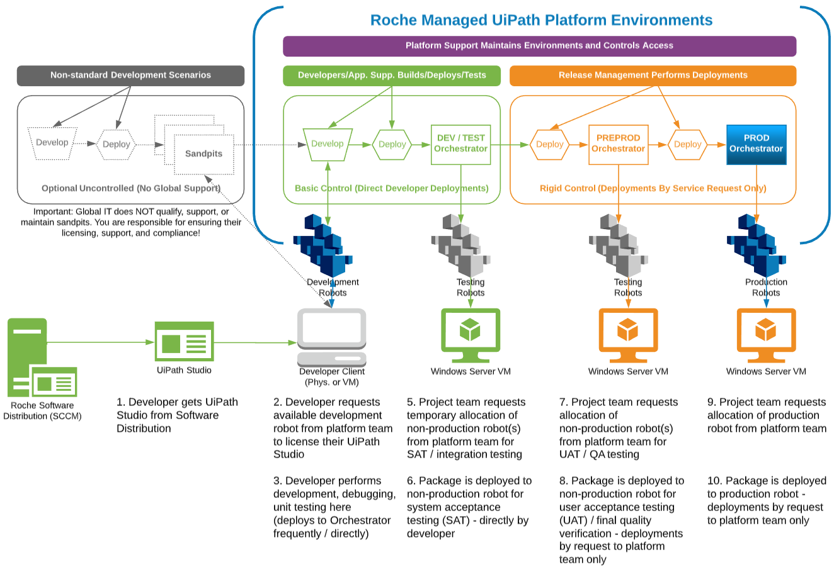
Environment Use and Deployments Lifecycle
Note: Each environment comes with a dedicated Folder in Orchestrator, one or more robots (and robot servers), and optional access to Kibana for reporting.

Slide 25
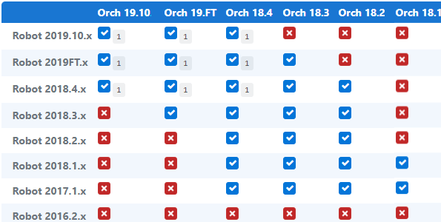
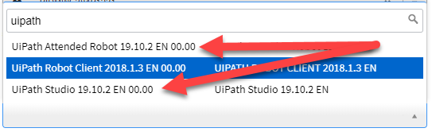
Version Compatibility
Supported Version - UiPath 2019.10
Compatibility Matrix - Spring 2020
Roche’s latest UiPath (R2) infrastructure is built on UiPath version 2019.10. This applies to all global components including:
UiPath Orchestrator
UiPath Robot
UiPath Studio
UiPath Studio and UiPath Robot (for attended robots) can be requested from the IT Software Distribution Portal. Simply search for “UiPath” under “...needed software” and select the latest version of UiPath Studio or Robot.
Note: Studio and robot versions greater than the current major infrastructure release, WILL NOT BE SUPPORTED. It is the responsibility of the project teams to ensure that they are developing with a studio and robot version that is equal to (strongly recommended), or at least backwards compatible with (see table on right) the current global version of Orchestrator. Minor versions are not important in determining compatibility, so you can use the latest patch level of the compatible major version, e.g., 2019.10.4.
See about backward and forward compatibility on the UiPath website for the latest information.

Slide 26
Other relevant Governance Links
Roche Global Directive Generic Identities (PL ID 2433699) - References newly available and compliant Robot generic account type
Roche Software RoBOT Security Standards (PL ID 21818122) - Global security governance impacting robots and chatbots
Roche SAP Security Group - Governance Overview Site - Additional important governance resources impacting Roche SAP systems
Roche UiPath RPA Developer Guidelines and Best Practices - Important coding quality standards and requirements

Slide 27
Environment Links and Access
Latest Orchestrator instances, and how to access them

Slide 28
Environment Links
Environment | Region | Url | Tenancy name
Production | Global | https://emea-prod-uipath.roche.com | Default (leave blank)
PreProd | Global | https://emea-preprod-uipath.roche.com | Default (leave blank)
Dev/Test | Global | https://emea-dev-uipath.roche.com | Default (leave blank)
Dev/Test | Global | https://emea-dev-uipath.roche.com | “Bravo” Named-User Licensing Customers

Slide 29
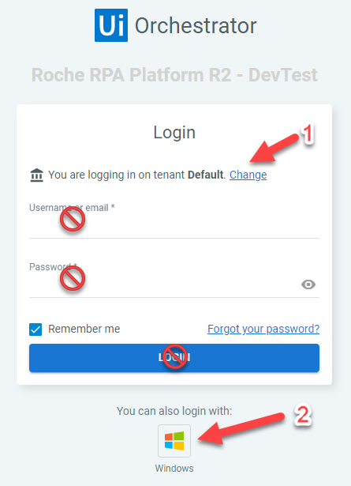
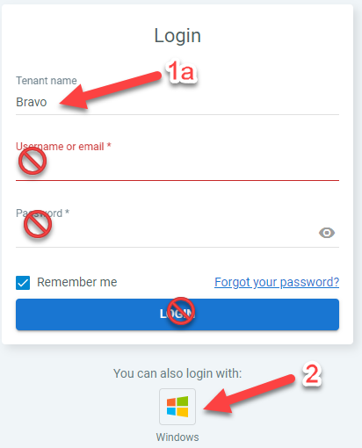
How to login
At Roche, UiPath Orchestrator is configured to use windows authentication. To login, navigate to the desired Orchestrator instance and do the following:
If not accessing the tenant displayed by default, click the “Change” link unhide the Tenant name box. Otherwise, go to step 2.
Type the name of the desired tenant in the “Tenant name” box.
Leave all other fields blank and click the “Windows” button at the bottom.
For a full list of available environments, see Environment Links.
Note: If you have issues logging in using Chrome, try using Internet Explorer instead.

Slide 30
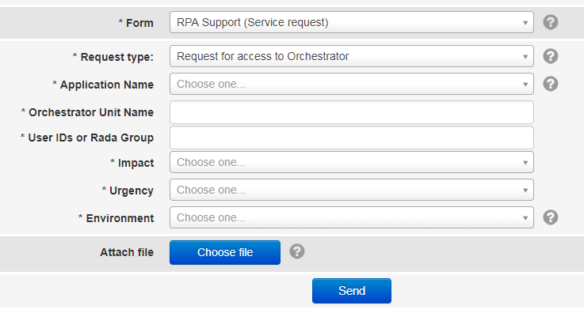
Don’t have access?
Access is granted on a per-process basis within a given Unit in UiPath Orchestrator. If you know the owner of the Unit, reach out to them to request access. If not, you can submit an RPA Support (Service request) at:
https://webforms.roche.com/rpa_platform

Slide 31
Platform Services and Contacts
What we do and how to contact us

Slide 32



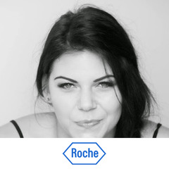
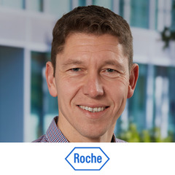

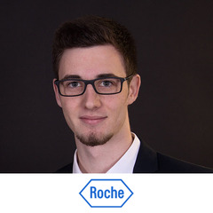


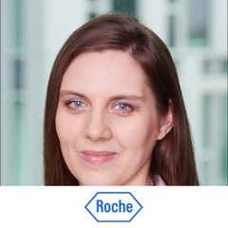
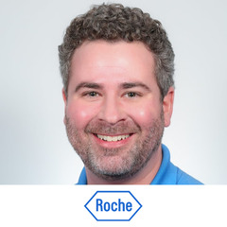


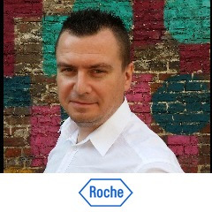
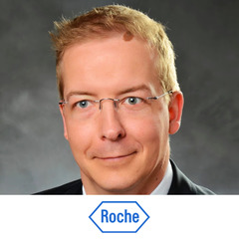

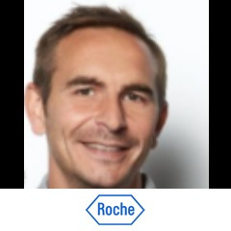
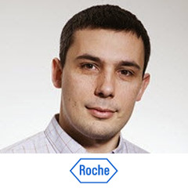
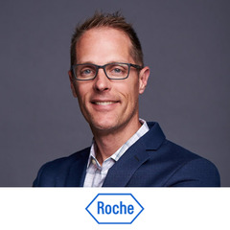
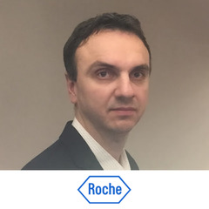
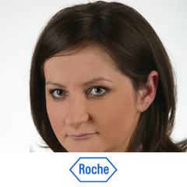



Experienced people behind the Service
Chatbots Team
Martin Chmielewski
Service Owner
Szymon Rdesiński
Platform Architect
Katarzyna Busse
Delivery Manager
Oliver Zeun
Integrated Service Owner
Micha Gerdes
Component Owner
Manuel Herzog
Automation Consultant
Marcin Stachowiak
Stream Lead
(Capgemini)
Anna Casquet- Ławrynowicz
Delivery Executive
Robotic Process Automation Team
Chase Channell
Service Owner
Kamil Marcinkowski
Platform Architect
Katarzyna Busse
Delivery Manager
Monica Bazan
Head of Workplace Automation
Łukasz Chorzępa
Automation Architect (Chatbots & RPA)
Markus Loetscher
Automation Consultant
Anupam Das
Stream Lead
(Capgemini)
Ben Sharp
Automation Consultant
Piotr Szydłowski
Factory Delivery Manager
Digital Process Automation Team
Andrew Amrhein
Service Owner
Dominik Rozbicki
Platform Architect
Anna Kukiełka
Delivery Manager
Paweł Bochenek
Service Coordinator
(Capgemini)
Nico Moresino
Automation Consultant
Sudit Sengupta
Stream Lead
(Capgemini)

Slide 33
Compose your automation
We offer tailor-made service that meets your business needs and ensure seamless customer journey, no matter which service components you choose.
Automation Consultancy
(optional)
End-to-end automation consulting will become a catalyst for innovation on a global basis.
Project Delivery
(optional)
Standardised implementation of PoC, automation projects and code changes with smooth handover to operations.
Application Support
(optional)
Ensuring smooth application operations and end-user support.
Platforms Maintenance & Operations
Licenced access to enterprise platforms for Robotic Process Automation, Chatbots, Digital and Business Process Automation, reusable cross-application components and scalable infrastructure.
Automation Center of Excellence
We enhance automation governance in Roche providing roadmaps, guidelines, trainings, best practices, and other accelerators.

Slide 34
RPA Platform Support
In Scope
Out of Scope
Benefits
Managing and assuring access to global, centralized, Roche compliant RPA Platform
UI Path Licence Management & provisioning
Release Management (application deployments and their coordination)
RPA Infrastructure management for your bot:
VMs provisioning, configuration, maintenance
UI Path Client software distribution & packaging
ServiceNow configuration
Issues handling:
High-level investigation of issues
Resolution for platform related problems
Escalation point for Application Support
Center of Excellence - source of RPA knowledge at Roche - architecture, guidelines, best practices, roadmaps, upgrades etc.
Platform Monitoring (central components health check)
Application Support services:
Resolving issues related to the process automated using RPA
Bot changes / bug fixing / enhancements related to process design / handling bot adjustments due to platform version upgrades
issues/upgrades related to business application (e.g. SAP, ARIS)
Local RPA solutions support (outside of central RPA platform)
Automated process (bot) monitoring
Roche-negotiated rates
Ready to use service - no technical knowledge required
Licence management & optimization
Roche IT Quality compliant
Seamless upgrades
High availability environment & disaster recovery
Stable & experienced team already in place
Roche standardized SLAs
Platform operations provides key services to support the running of the UiPath platform, which consists of UiPath Orchestrator, Kibana (reporting and KPIs), UiPath Robots, UiPath Robot Servers, and client software packages.

Slide 35
Platform Support: Release Management Details
WHAT WE DO?
WHEN TO CONTACT US?
HOW TO CONTACT US?
Coordinate RPA changes
Ensure the communication
with Projects Team
Coordinate the deployment
Collect all required approvals
for deployment
Coordinate RPA platform
downtimes
If you want to set up new project
If you want to open a new change
If you want to deploy a change to already existing project
If you need help with filling the Initial/ Final IA/ webform
Service hours:
Monday - Friday
9 am - 5 pm CEST
Team email:
global.rpa_release_management@roche.com
WebForm:
https://webforms.roche.com/rpa_platform

Slide 36


Platform Support: Support and Operations Details
WE SUPPORT YOU WITH:
Incident management
Problem management
Access management
Service Request Management
SO...WHEN TO CONTACT US?
Service outage of Orchestrator
Issues with Orchestrator components (database, web site, search, etc)
Access management to UiPath Orchestrator (roles and permissions)
Create robots and connect them to their VM or laptop
SERVICE HOURS:
Monday - Friday
9:00-05:00 CEST
First line of the contact:
WebForm:
https://webforms.roche.com/rpa_platform
Team email:
global.rpa_support@roche.com
‹#›

Slide 37
Application Support
In Scope
Out of Scope
Benefits
Bot monitoring
Technical process monitoring
Still require attention to verify proper behavior from business perspective
Analysis & investigation of issues related to automated process
Bot enhancements:
Feasibility assessment & effort estimation regarding scope extensions of existing bots
Bot enhancements implementations*
Ensuring bot compatibility
Post platform upgrade
After BU application changes (e.g. SAP)
Collaboration with cross-functional teams
Bot quality verification
Transition process
Change Requests resulting in new bot’s creation**
Bots not running on Roche global RPA platform (can be supported, but will require transition process)
Assuring automated business process operating successfully in changing IT environment
Stable team available to provide support, reacting immediately
Single point of contact for bot-related topics
Reduced financial impact due to planned bot downtime [not clear]
Application support is the first line of support for your robots. This team has the knowledge of your custom RPA applications and the business process that they support. They help to troubleshoot, diagnose, maintain, and fix your robots when problems arise.
*up to agreed capacity / depending on chosen plan (Plus/Premium)
**can also be supported by our services, but following project delivery path

Slide 38

SLA
Priority | Business Operations
P1 | Response: 30min Resolution: 8h
P2 | Response: 60min Resolution: 12h
P3 | Response: 2h Resolution: 24h
P4 | Response: 4h Resolution: 36h
P5 | Response: 8h Resolution: 48h
Priority Matrix |  | Impact
 |  | P1 | P2 | P3
Urgency | P1 | P1 | P2 | P3
 | P2 | P2 | P3 | P4
 | P3 | P3 | P4 | P5
*SLA is calculated for service hours

Slide 39
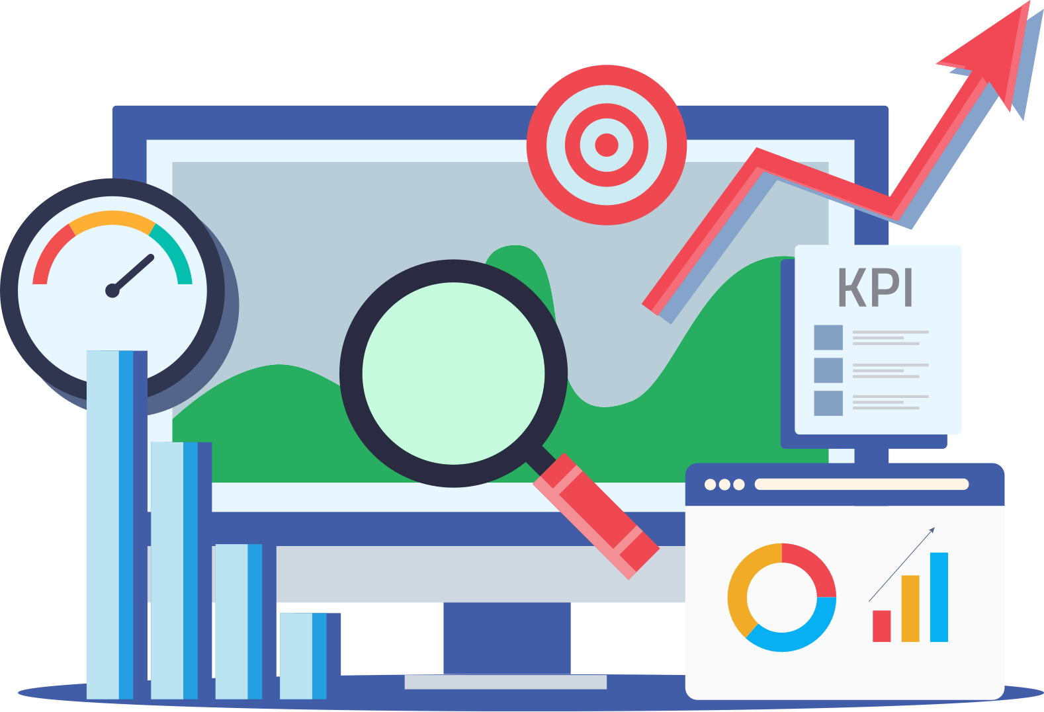
KPIs
KPI name | Service Level Target
Incident Reacted within SLO Target | ≥ 90%
Incidents Resolved within SLO Target | ≥ 85%
Requested Items Open Beyond 30 days | ≤ 10% - End user requests ≤ 50% - Application enhancement requests
Requested Items Fulfilled within Delivery Objective | ≥ 90%
Problems Fully Resolved | ≥ 90%
Valid Problems | ≥ 95%
Changes Implemented by Planned End Date | ≥ 90%
Unsuccessful Changes | < 5%

Slide 40
Escalation Path / Main contacts
1st Level
Application Service Delivery Manager
To be provided by application team
3rd Level
Workplace Automation Delivery Manager
Katarzyna Busse
5th Level
Workplace Automation Team Head
Monica Bazan
2
4
1
3
5
2nd Level
Workplace Automation RPA Service Coordinator
Anupam Das
4th Level
Workplace Automation Service Owner
Chase Channel

Slide 41
Training
How to learn more about UiPath

Slide 42
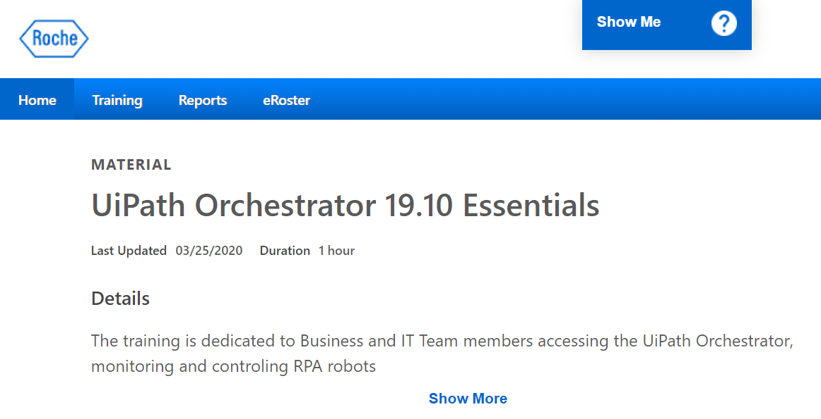
UiPath Essentials Training
Required prerequisite training for all users requesting access to UiPath Orchestrator in PreProd or Production environments. Available in Cornerstone.

Slide 43
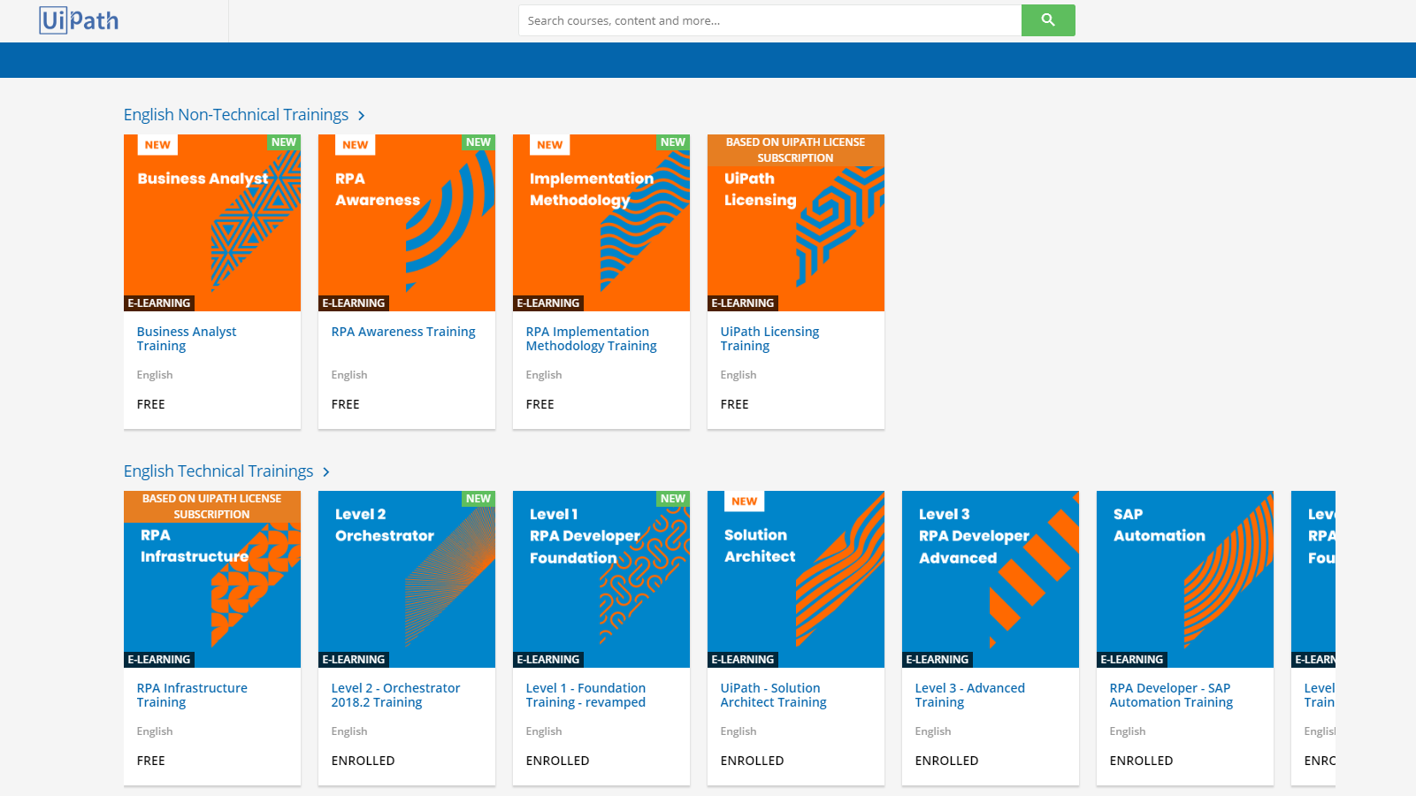
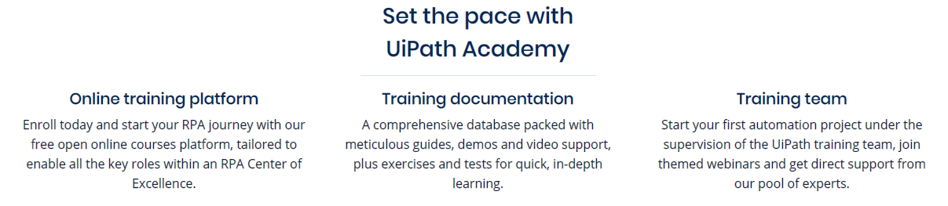
UiPath Academy
Register for the free online UiPath Academy for courses and learning plans tailored to your specific role!

Slide 44
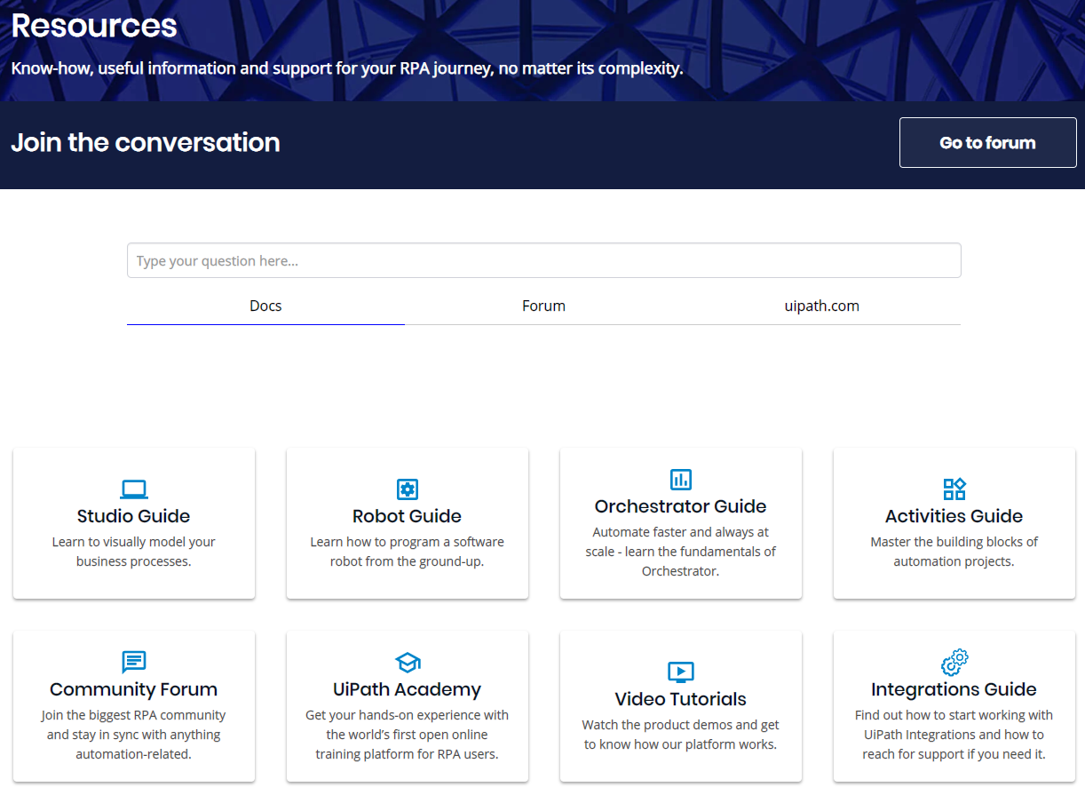
Free Guides and Resources
A collection of other free learning content
Visit the UiPath guides and resources page for free access to other helpful content including guides, video tutorials, and post your questions in the community forum

Slide 45
Part II: Engagement Model

Slide 46
Intro to the DPA Engagement Model
High-level engagement model and processes

Slide 47
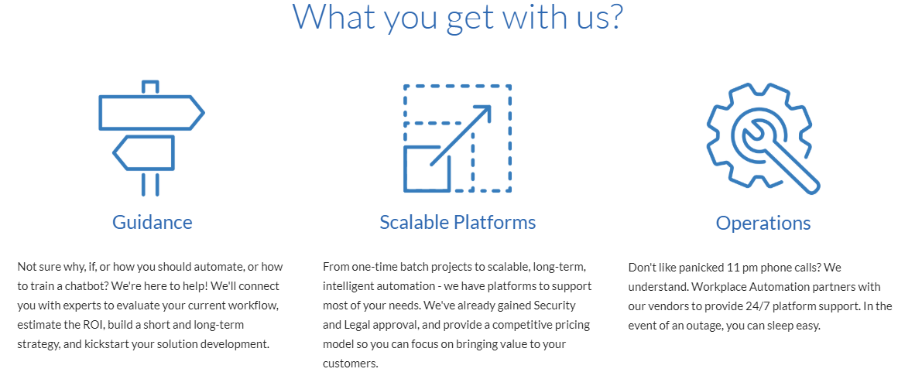
Engagement Model Workplace Automation Service
Workplace Automation
Satellite
CoE
Satellite
CoE
Satellite
CoE
APAC
EMEA
Central
APAC
EMEA
The Rest
As a central shared service provider, our team provides leadership, best practices, research, support and/or training for the workplace automation area. In detail, we’re driving a hybrid approach of a CoE: Different business functions have distinct needs and desire flexibility while adhering to global governance and strategy.
Each region/business function that is ready to invest in a Satellite CoE can choose to do so. All other engagements would be fielded by the central team (the Automation Factory).
Each satellite CoE may layer it’s own governance and choose a different delivery strategy.

Slide 48
Engagement Model DPA Portfolio
CPA
TBD
RPA
UiPath
BPA
K2
DPA
Pega
Citizen Process Automation
Individual or team productivity
Experimentation
Ad-Hoc
Missing
Robotic Process Automation
Projects with immediate results
Immediate value
Opportunistic
Ready
Business Process Automation
Small to medium departmental projects
Local implementation
Tactical
Ready
Digital Process Automation
Transformational programs
Global/regional implementation
Strategic
Ready

Slide 49
Engagement Model Model
Capture high level requirements
Determine initial fit for the solution space
Explain the high level engagement process
Capture
Ensuring the idea is feasible, costs & efforts are aligned
High level project plan agreed upon
Application is a fit from Security / Quality / Privacy perspectives
Discover
Delivery of applications within scope, budget, and timelines
Applications are documented as per Roche standards
Deliver
Support structure is agreed upon
Resources are allocated
Knowledge transfer is performed
Operate
Ensuring continuous improvement
Enhancement

Slide 50
Engagement Model Development Models
Small-size Waterfall
Mid-size Hybrid
Large-size Aglie
Capture
First customer contact
First customer contact
First customer contact
Discover
Define
Define
Define
Design
Design
Design
Deliver
Implement
Implement
Release
Implement
Test
Test
Release
Release
Test
Operate
Operate
Operate
Operate
Enhance
Enhance
Enhance
Enhance

Slide 51
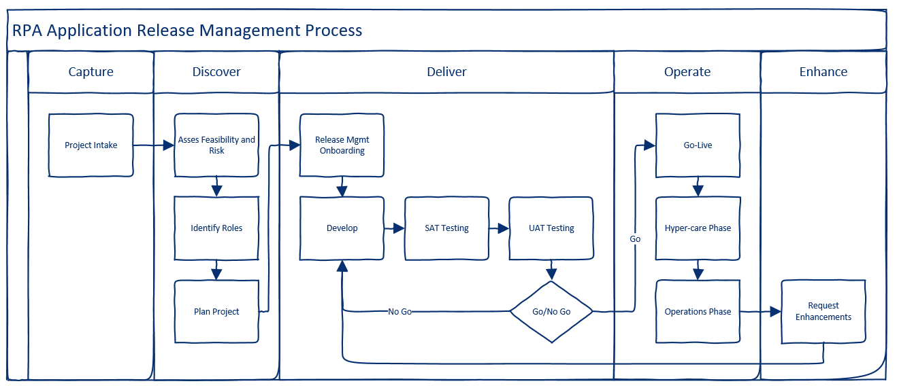
Engagement Model Tailored for RPA

Slide 52
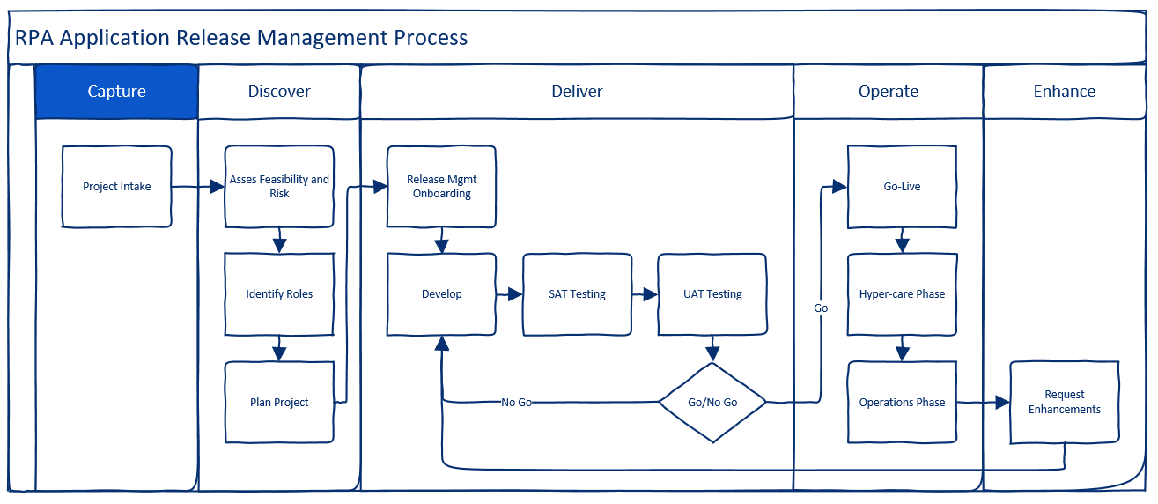
Capture
Engagement Model Phase I: Capture

Slide 53
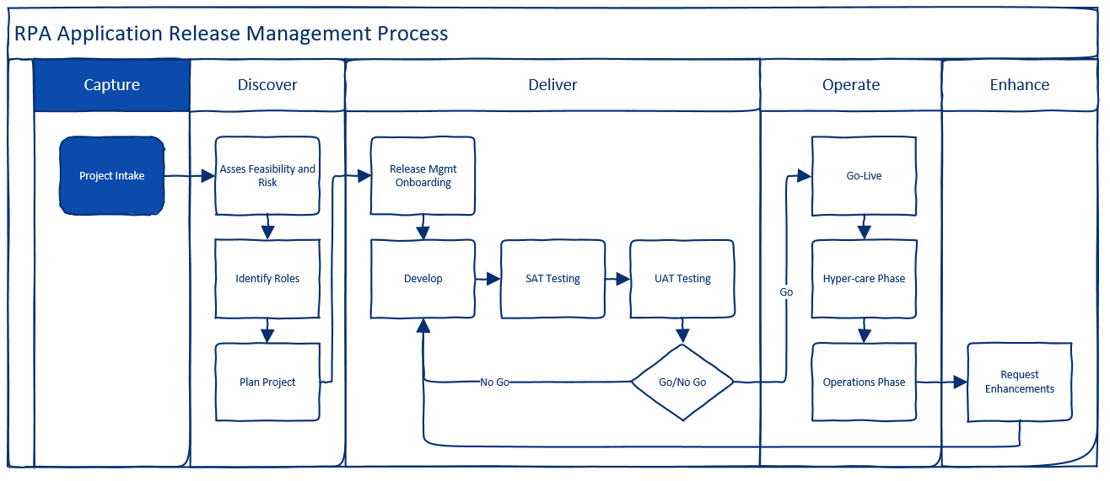
Capture: Step 1 of 1 - Project Intake
Project intake is quite simple:
You will: Reach out to the portfolio manager, platform component owner, and/or lead business analyst to schedule an intro call. During the call we will:
You: Present your use-case/automation idea
All: Capture initial idea information (high-level)
Key contacts
As-is process - How it operations today
Delivery partner - Can the Automation Factory help to further asses, design, and deliver?
Timelines - Discuss time constraints and expectations
All: Decide initially if the use-case could be a good fit for further assessment of RPA
All: Next steps - Align on next steps
Platform team will: Enter captured use-case into RPA demand pipeline

Slide 54
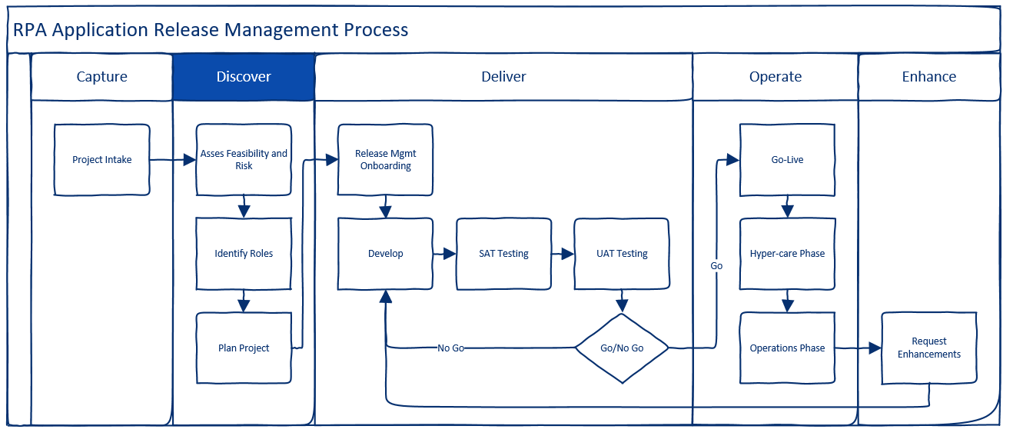
Discover
Engagement Model Phase II: Discover

Slide 55
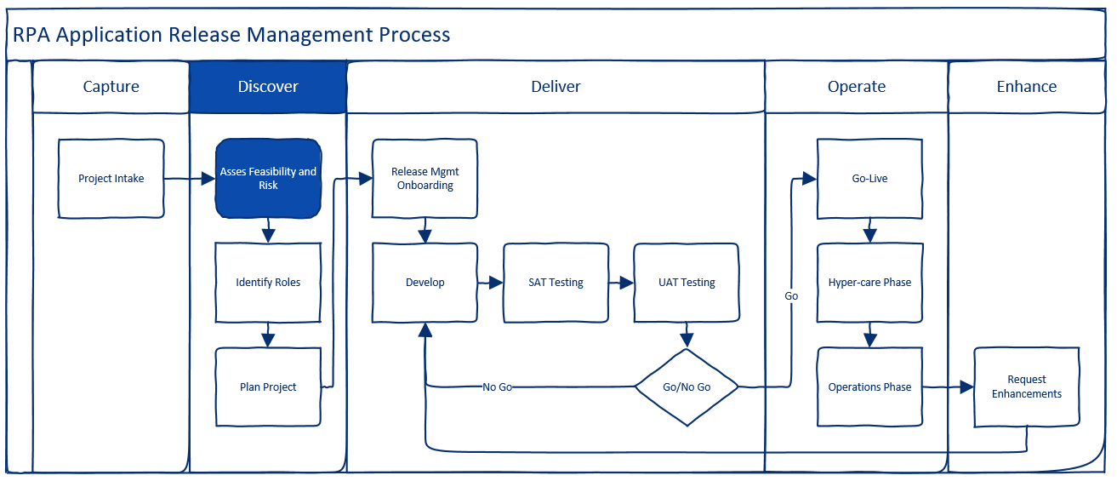
Discover: Step 1 of 3 - Assess Feasibility, Risk, and Success Factors
The next step is to engage with your deliver partner (if applicable) and perform the following assessments. It is highly important to start these right away to avoid unplanned delays later in your project!
Process Discovery - Identify and document the areas of your process that could benefit from RPA
Define Key Success Criteria and measures
Cost/Benefit Analysis - Quantify the benefits of automating in terms of anticipated cost savings and revenue growth and weigh them against the cost of developing and operating your robots. Will you get a return on your investment?
Identify Key System Contacts - Reach out to the owners of the various systems that your robot will work against. Will you have challenges getting access to those systems using robots? If so, what are the specific hurdles, and who can help overcome these challenges?
System Risk Assessment - It is required that you complete a system risk assessment in iRAAM before any development can begin. Once complete you will be assigned an IT Quality contact who will help you assess the overall risk and whether or not any additional mitigation steps are required.

Slide 56
Technology section in the System Risk Assessment
Will completing the SRA, you may not know all of the correct answers. Just fill it out to the best of your knowledge, and your IT Quality contact will help you review and update it later. However, when filling out the “Technology” section please use the following values as they will always be the same:
Which of these does the system include? Select all that apply.
Software
Software
RPA (Robotic Process Automation)
Is the system custom-developed or purchased?
Purchased Software
Purchase type
Configured
Vendor Name
UiPath
Contact Name
Chase Channell
Contact Email
chase.channell@roche.com
Please characterize the nature of the services provided by the vendor
Purchased Software
Scope of vendor’s service(s), access to, or deliverable(s) to Roche
Vendor only sells and licenses UiPath Orchestrator, Robot, and Studio software. All infrastructure platforms are hosted on-premise in Roche data centers. No access to Roche platforms or system data is granted to the UiPath vendor.
What is Roche’s experience with the system technology?
Existing technology already in use at Roche
For all other questions in the SRA, answer as they pertain to your specific process and automation.

Slide 57
Discover: Step 2 of 3 - Identify Roles
At a minimum, the following roles must be defined to ensure the success of the project. You will be required to provide contact names prior to deployment on the platform.
Process Owner - Accountable for the impacted business process along with its objectives and performance.
Application Owner - Business owner of the to-be RPA automation(s) responsible for business delivery, along with functioning and services of the application.
Credential Owner - Owner of the robot identities. Accountable for maintaining identity lifecycle of Roche accounts used by the robots to access business system, updating passwords, and requesting/maintaining access rights to Roche systems on behalf of the robots.
Project Manager - Plans, executes, and finalizes the project according to targets and objectives set for time of delivery, budget, and quality.
Development Partner - Entity responsible for design, development, and delivery of your RPA automations. You can use our strategic delivery partner (the Automation Factory), or choose one of your own.
Application Support Partner - Entity responsible for maintaining the RPA automations after go-live, e.g., troubleshooting, bug-fixing, and change management of your automation packages. You can use our strategic delivery partner (the Automation Factory), or choose one of your own.
Lead Developer - Responsible for disseminating platform governance and best practices to the development team and ensuring that they are followed. Serves as the primary technical contact of the automation while under development.
Important Note: The platform support team maintains Roche environment access for strategic vendors only. If not using Capgemini and RGITSC, the project team will be responsible for onboarding any external resources. For help, contact EXBP Services.

Slide 58
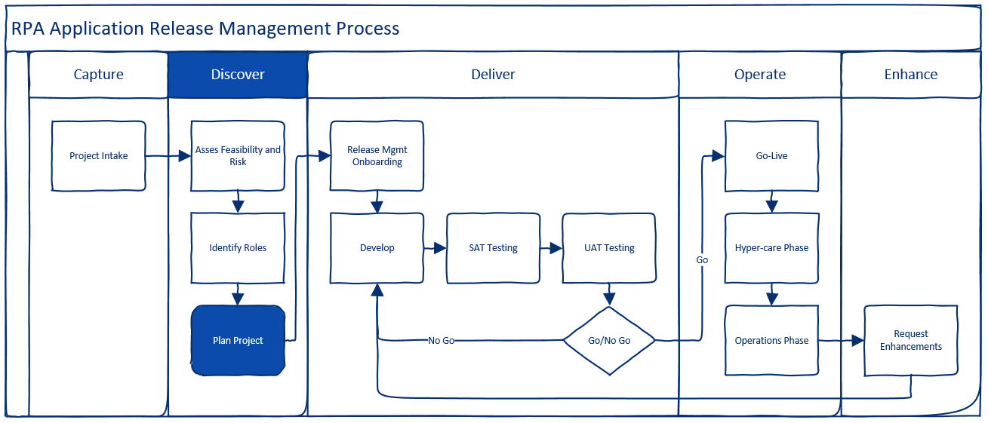
Discover: Step 3 of 3 - Plan your project
Finalize roles and responsibilities
Define scope
Agree on timelines
Engage with IT Quality
Engage with delivery and applications support partners
Decide on an appropriate and unique name for your application. Names should include location or region and the business process of function:
Examples:
Global Procurement Contracts
Indianapolis Site IT
APAC Commercial Operations
This name will also be given to your unique Unit in UiPath Orchestrator

Slide 59
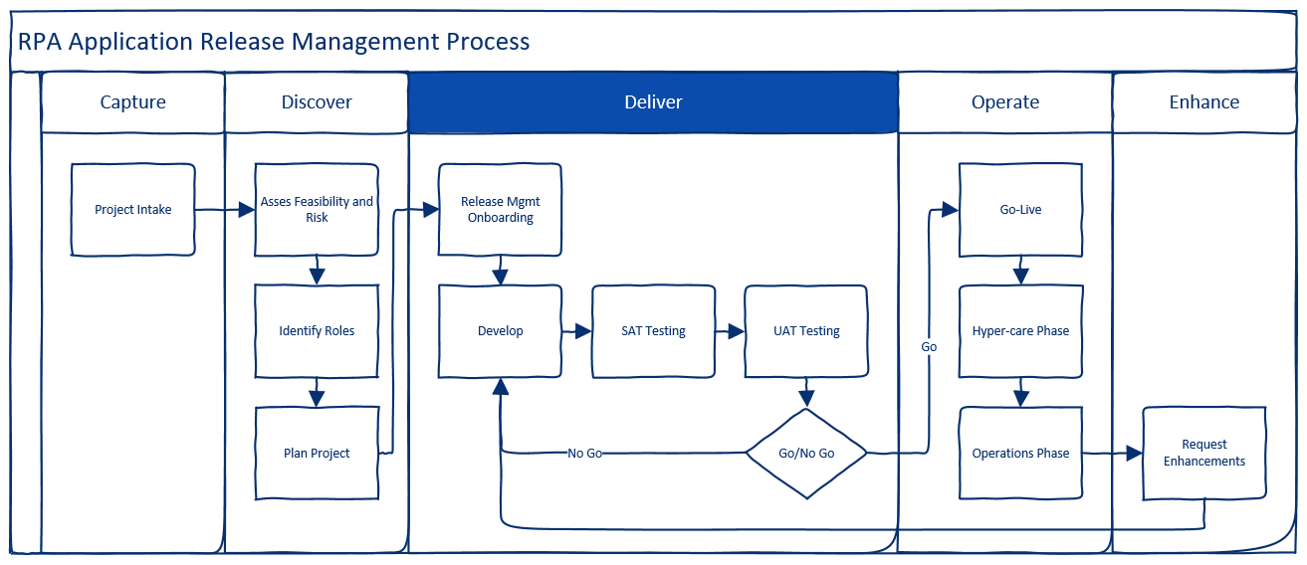
Deliver
Engagement Model Phase III: Deliver

Slide 60
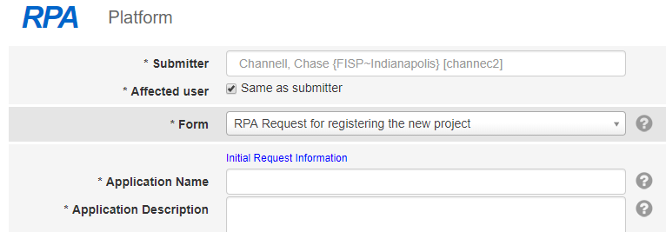

Deliver: Step 1 of 5 - Release Management Onboarding
A. Submit New Project Request Form
B. RM Onboarding Call
Submit an “RPA Request for registering a new project” form via the RPA Webforms. Fill all required fields to the best of your knowledge.
After the form is received, you should receive an invite from the release management team for an onboarding call. During this call they will outline the platform release management process and answer any questions.
Contact Info
global.rpa_release_management@roche.com
Service Hours
Monday - Friday
9am - 5pm CEST

Slide 61

Deliver: Step 2 of 5 - Develop
Develop prerequisites
A. Create RADA Groups for your Unit
Group Owner: Application Owner
Request an AD group prefix (unless you already have one)
Once your prefix is ready, create the following group in your unit:
<MyRADAPrefix>_Developers
Add the appropriate users into each new RADA group to ensure access to your new Unit once created
For a how-to on RADA, see the RADA Quick Reference Guide or visit the RADA Intranet page for detailed information.
B. Create Robot Identities
Identity Owner: Robot Owner
Log into your identity management tool
For Roche Users: Enroll
Request at least one generic account for each environment using generic account type=”Robot”, e.g:
rxfisd1- Dev
rxfist1- Test
rxfiss1 - Pre-prod (stage)
rxfisp1 - Prod
Talk to the owners of the systems that your robots will work against to identify if there are any specific account type requirements. At minimum, you will require two identities (one for non-prod and one for prod environments).
For a how-to on Enroll, see the Enroll Intranet page.

Slide 62
Develop prerequisites cont.
C. Obtain UiPath Studio Licenses for your developers
Who: Application Owner or Development Partner
The preferred method is to obtain studio licenses from the workplace automation team (via a central procurement/chargeback model). This can be initiated when you request studio from the IT software portal or when you request a development virtual machine.
If you need to purchase a Studio license directly from UiPath (paid by Roche), you can work with your local procurement team to create a PO using Roche negotiated rates. The UiPath purchasing master agreement can be referenced in Ariba by ID: 0010298276.
For your reference, the MPA and negotiated pricings are also linked here:
Roche UiPath Master Purchasing Agreement
Negotiated License Rates
Note: After the platform upgrade in 2020, we will switch to a central purchasing model with charge-backs to simplify this.
D. Share RPA Governance with Development Partner
Who: Project Manager
Developers must:
Read and understand the Roche RPA Code Review Process and Developer Guidelines.
Acknowledge that a peer code-review will be completed prior to the first deployment.
Ensure they are developing with a supported version of UiPath Studio.

Slide 63


Develop prerequisites cont
E. Submit the development environment request
Who: Lead Developer
Once all prerequisites are complete, you can submit an “RPA Support (Service Request)” via the RPA Webforms to request your development environment.
The platform support team will work with you to create a development instance of:
Orchestrator Unit
Robot(s)
Robot Server(s)

Slide 64

Development
A. Initiate Change Requests
Once you receive the go-ahead from the release management team that your project request is captured, submit a “Request for change in existing project” via the RPA Webforms.
This will automatically trigger the change request workflow in ServiceNow and allow you to make deployments on the controlled environments.
Select your application name from the dropdown list and fill out the rest of the fields to the best of your ability.

Slide 65

Development cont.
B. Development
Your development partner begins developing your application.
Actual development may be agile, however, and involve multiple sprints of design, development, and testing, and possibly PoCs.

Slide 66







RPA Delivery Tool kit
PDD, SDD, UAT Report & OSP needs to be stored on PLV2 and should be approved by e-signature
Link to Project Library V2
How to request PLV2 Access?
Though not required at this time, use of the following templates are strongly recommended to ensure a successful implementation and hand support handover of your automation!
PDD
Process Design Document : This document contains requirements, Automated process flow, all necessary process details and test cases
Author: Business Analyst; Key Contributor: Business SME, Functional expert of connecting system; Approver: Business SME/Process Owner
Recommended to have: Video recording of the process
SDD
Solution Design Document : This document contains technical requirements and the robot artefact design
Author: RPA Developer;; Approver: Technical Lead/RPA Solution architect
UAT Report
UAT Report: Formal UAT will be conducted in the Pre-Production environment. Outcome of this User Acceptance Testing will be recorded in the UAT report
Author: Business Analyst;; UAT should be conducted by Business SME Approver: SME/Process Owner
OSP
Operational Handbook/Support Plan: Detailed document enlisting all the information required to operate and maintain the robot. OSP contains information regarding resolver groups who needs to be contacted during an incident, error handling procedures and support model.
Author: RPA Developer; Approver: RPA Operations Lead
Plan
RPA Delivery Plan (Optional): Recommended to maintain a detailed plan during Robot Delivery Phase so track and update activities
Author: RPA Delivery Lead
Contact for advice:
Winfried Hann (Fin/Proc)
Chase Channel (non-Finance/Procurement)
Link to Re-usable Templates
You could also follow Roche PMM

Slide 67

Deliver: Step 3 of 5 - System Acceptance Testing (SAT)
SAT prerequisites
A. Document functional specifications
Who: Lead Developer
To ensure that your automation can be adequately supported, understood, and maintained. Functional specifications must be documented and delivered by the development team prior to any deployment on the test, pre-prod, or prod environment.
B. Gain finance approval for service charge-backs
Who: Process Owner
The process owner is responsible for understanding the costs of the platform (licensing and support fees), and gaining any necessary financial approvals through their local process to authorize chargebacks.
Additionally, the process owner must provide the most appropriate cost element for IT charging from the pre-approved list of IT chargeable elements.
For more details on platform costs and charge-back model refer to the charge-back mechanism.

Slide 68
SAT prerequisites cont
C. Choose an Application Support Partner
Who: Application Owner
Before your first deployment onto the global platform you must choose your application support partner and agree on a support plan with them.
Each automation and process is unique. Depending on your needs and budget, you may choose either your local business-facing IT organization, the global Workplace Automation application support service, or an external partner of your choosing.
Regardless of who you choose, this information must be captured to insure that incidents and change requests can be routed appropriately after go-live.
D. Provide list of required client apps and interfaced systems
Who: Lead Developer
To ensure that the platform team can accurately track and configure your test, pre-prod, and prod environments we will need a list of your robot’s dependencies, including:
Client Applications - List of applications that must be installed on the robot’s client device (laptop for attended robots, server for unattended robots) to support the robot’s automation.
Interfaced Systems - List of remote systems that the robot will interact with, e.g., ERP, Document Management, HR, external websites, etc.

Slide 69
SAT prerequisites cont
E. Identify robot licensing needs
Who: Lead developer and Application Owner
Finally, at this time you must agree on the number and types of robots that you will need to run your automation at go-live, e.g., 2 unattended robots and 3 attended robots.
The platform team purchases licenses in bulk, so it is important to get an accurate count of your planned robots at this time to avoid any project delays due to procurement of additional licenses.

Slide 70

System Acceptance Testing (SAT)
A. Code Review
Who: Platform Support Team
Before the automation package can be deployed on a controlled global platform, the automation code must be reviewed by the central team to ensure safety and quality.
At this time, an RPA expert will check the code and functional specifications for:
Adherence to guidelines and best practices (quality check)
Code does as it is documented and intended (sanity check)
Code does not contain any hidden or malicious activities (safety check)
B. Submit deployment request
Who: Project Manager
Next, submit an “RPA Request for Deployment” via the RPA Webforms so that the RM team can deploy your latest package into the test or pre-prod environment.

Slide 71
System Acceptance Testing (SAT)
C. Test Execution
Who: Project Team (Technical Members)
Once the package is deployed by the RM team, you can begin your system acceptance testing. During this test phase, the technical team tests the robot(s) and automation in a separate environment verify that it meets specified technical and integration requirements. SAT factors should include:
Use of generic robot account - Ensure that the non-human identity can authenticate with the remote systems
Integration point testing - Ensure that the robot can connect and work with remote system test environments
Configuration testing - Ensure that the robot client machine and Orchestrator configuration works in a separate environment, and that dynamic variables are adequately defined.
We strongly recommend performing SAT in the UiPath Test environment. However, you may optionally perform this stage in pre-prod if your development model does not support this 4-staged approach.
Note: You must NEVER connect a non-production robot to a production Roche system without explicit approval from IT Quality and Security.

Slide 72

Deliver: Step 4 of 5 - User Acceptance Testing (UAT)
UAT prerequisites
A. SAT Prerequisites Complete
If for any reason, your project did not got through an SAT round, you must complete the outstanding SAT prerequisites before continuing with UAT.
B. Code review complete
Additionally, if not already completed, the code review must be performed at this time.

Slide 73

User Acceptance Testing (UAT)
A. Submit deployment request
Who: Project Manager
Next, if not already deployed, submit an “RPA Request for Deployment” via the RPA Webforms so that the RM team can deploy your latest package into the pre-prod environment.

Slide 74
User Acceptance Testing (UAT)
B. Test Execution
Who: Project Team and Business Users
Once the package is deployed by the RM team, you can begin your user acceptance testing. During this test phase, robot(s) and automation are tested for acceptability. The purpose is to evaluate the system’s compliance with the business requirements and assess whether it is acceptable for production release.
We require that your perform SAT in the UiPath Pre-prod environment. No SAT or UAT testing should ever occur in production.
Note: You must NEVER connect a non-production robot to a production Roche system without explicit approval from IT Quality and Security.

Slide 75

Deliver: Step 5 of 5 - Go/No Go
Go/No Go Decision
Formal decision on whether to “go-live”
At this time it is important for your project team and/or governing body to review the test results and decide on the next step:
Go: Continue to the operate phase and push your latest code into production
No Go: Changes or fixes are needed and the code should go back to the development phase

Slide 76

Operate
Engagement Model Phase IV: Operate

Slide 77

Operate: Step 1 of 3 - Go-Live
Go-Live Prerequisites
A. Training
Prior to go-live you must ensure that the users who will interact with the robots and Orchestrator understand their role and are adequately trained.
A basic training is available in cornerstone for all roles as a prerequisite to platform access: UiPath Orchestrator 19.10 Essentials
If additional training is needed, it should be provided by the project team.
B. Onboard application support partner
Ensure that your application support partner is onboarded and ready to support your robots. This will include:
Agreement on cost and resources
Alignment on support hours and SLAs
Adequate knowledge transfer of developed automations
Contracts executed (if required)

Slide 78
Go-Live Prerequisites cont.
C. Define hypercare plan (optional)
Agree with your platform and application support teams on an hypercare period (if desired), in which close supervision and informal support requests can be raised until the automation(s) are stable.
D. Complete SRA, DCR, and Security Exception Approvals
Who: Project Manager
Prior to go-live, it is the responsibility of the project manager and ultimately the accountability of the process owner to ensure that all outstanding compliance documents are signed and effective. This means:
SRA - (Signed and Active)
DCR - (Not Required or Signed and Active)
Security Exceptions - (Not Required or Signed and Active)
Failure to have these deliverables completed will stop the production deployment!

Slide 79

Go-Live
A. Submit deployment request
Who: Project manager
Submit an “RPA Request for Deployment” via the RPA Webforms so that the RM team can deploy your latest package into the prod environment.
B. Schedule production release
Align with the release management team and agree on a coordinated time that your code will be pushed into production.

Slide 80
Go-Live
C. Production Launch
At the coordinated time, your latest automation code will be pushed into the production environment. Your latest changes are now live.

Slide 81

Operate: Step 2 of 3 - Hypercare
Hypercare period
During the hypercare period, all platform support, application support, and end-user teams will be aware of heightened risk to new changes being deployed in the production environment. All teams agree to prioritize issues and be readily available for responsive monitoring and troubleshooting until the hypercare period ends and the automations are deemed stable.

Slide 82

Operate: Step 3 of 3 - Operations
Regular operations
During the operations period, the robots and automations are now in full operation and are considered stable. During this phase, standard IT Service Management (ITSM) practices are followed. The following apply during the operations phase:
Monitoring: Regular monitoring of system and robot health
Issues or errors: Raise IT incident for support (Incident management)
Recurring/long-running issues: IT support will raise a problem ticket (Problem management)
Standard IT requests: Non-issue type requests like new users or requesting additional robots (Request Management)
Requesting changes: Requests for new functionality or robot behavior changes (Change Management)
Service chargebacks: Standard semi-annual chargebacks for robot licenses, platform services, and support based on agreed figures

Slide 83

Enhance
Engagement Model Phase V: Enhance

Slide 84

Enhance: Request Enhancements
Continuously Improve and Grow
Most automation technologies require adjustments and tuning. After operating your robots for a while, you may identify areas for potential improvement, or come up with ideas for other parts of your process that can be automated.
The automation teams support you on your journey to continuously improve and evolve your automations in order to maximize your investment and drive greater cost savings and process efficiency!

Slide 85
Part III: Cost, ROI, and Chargebacks

Slide 86




RPA Pricing Model
Offering
In alignment with the overall creation of Workplace Automation as an integrated Service in GIS, we have adapted our financial model while offering new or enhanced services for our consumers. Apart from a mandatory package, RPA application owner will now have the option to extend the basic building requirements with further service support add-ons:
NEW
Support Add-Ons (optional)
Mandatory
Specific support add-ons for the development of your RPA application:
Robot Licence
Platform Operations
Carefree Package Basic
Carefree Package Plus
Carefree Package Premium
and
Project Delivery
and
or
or
24x5 coming soon
Licence cost per robot (UI Path)
Platform Lifecycle, Portfolio Management, Best Practices, Guidelines, Security Compliance, RM
- Application monitoring
- Incidents (8x5)
- Bug fixing
- Bot training
- per automation*
- Application monitoring
- Incidents (8x5)
- Bug fixing
- Enhancements (up to 20h/month)
- per automation*
- Application monitoring
- Incidents (24x7)
- Bug fixing
- Enhancements (up to 40h/month)
- per automation*
- Business analysis
- Development
- Testing
- Hypercare
- per automation*
5,440 CHF / year
6,500 CHF / year
11,940 CHF / year
10,644 CHF / year
(887 CHF / month)
35,400 CHF / year
(2,950 CHF / month)
141,900 CHF / year
(11,825 CHF / month)
Effort based
(T&M)
*Disclaimer: If you have more than 1 automation to be supported, feel free to contact us and we can discuss customizing the offer
Notes:
Attended: 1689 CHF for UI Path licence, 2400 CHF for Platform Fee

Slide 87



Application Support - CareFree packages - RPA
Service / Activity | Description | Basic 2-4MD 887 CHF per month | Plus 10-12 MD 2950 CHF per month | Premium 40-45 MD 11825 CHF per month
Incident, problem, request management | Investigation & root cause analysis Pro-active action initiation based on monitoring communication | Included | Included | Included
Application monitoring | Health checks through dedicated Kibana dashboard | Included | Included | Included
Service hours |  | 8x5 | 8x5 in application specific working hours | 24x5
Bug-fixing | Within capacity limit | Included | Included | Included
Minor application enhancements & change management | Implementation of minor enhancements within capacity limit Evaluation of change requests Change planning |  | Enhancements up to 20h not requiring solution design modification | Enhancements up to 40h not requiring solution design modification
Recommended for |  | Simple, non-critical automations | Medium-Complex, non-critical automations | Critical automations
24x5 coming soon
*Disclaimer: If you have more than 1 automation to be supported or specific support requirements, feel free to contact us and we can discuss customizing the offer

Slide 88


Project Delivery - RPA
We deliver T&M resources from Poland, Malaysia and India (Malesia and India coming soon)
All T&M rates are available on next slide
Every Project Request is being estimated on a case-by-case basis
To provide high-level / anticipated cost & time effort, check our T-shirt pricing model
Want to learn more on how we deliver RPA Projects?
RPA Project Delivery Plan Sample

Slide 89
Charging model - WBS
Consumer needs to provide a WBS to charge costs against it
WBS is a financial element where costs are allocated and expected costs are booked. In other words it is used to allocate money to specific Sites (e.g. Poland, Basel etc.)
Only when WBS is assigned we are able to charge & deliver our services
Charging is on monthly basis in fixed price model based on a selected support package (for Platform Fee, licences & Application Support) or T&M estimated per each development (for Project Delivery and custom enhancements)
WBS
IYYY.XXXXX.XX.XX
e.g. I126.35004.03.26.90

Slide 90
WBS - short guidance for Workplace Automation Business Partners [Business]
If you are the Business Representative (non IT)
If you don't know which WBS should be charged but you know a COST CENTRE please share it with us
Let us know who is your IT Partner - we will get in touch with them to align on the proper WBS usage
1.Cost center associated
2. MDMS update (workflow via CLARITY)
For Pharma IT the cost information needs to be maintained in CLARITY.
Projects, Small Project Collections & Enhancements are first created in CLARITY.
1
2
Business
PMO / Activity Owner
4. WBS creation in Omnimat
Omnimat and Perform refresh data few times per day and actual status of WBS is reflected in Omnimat.
Workplace Automation
Controlling
3. WBS creation in SAP & PERFORM
MDMS requests are reviewed and approved by IT Finance.
4
3

Slide 91
WBS - short guidance for Workplace Automation Business Partners [IT]
If you are the IT Representative
Check if your WBS matches required format for Informatics (example: I126.35002.00.06.00)
Make sure that “1291 Roche Poland” is on the list of Companies Names on your WBS. Otherwise this WBS can’t be used by RGITSC. The company name can be added only by the activity owner in CLARITY system
Let us know which WBS can we use
Business
IT
IT function
(SP&A, regions, etc. )
Cost center
e.g. CC 9825401000
WBS
IYYY.XXXXX.XX.XX
e.g. I126.35004.03.26.90
I stands for Informatics
XXXXX.XX.XX refers to the activity ID
e.g. 35004.03.26
This is what we need from you.

Slide 92
Calculating Savings and ROI
A common way of measuring ROI is by calculating reduction in human labor generated by an RPA implementation. This is often estimated using the following factors:
A robot works 4 -10 times faster than a human (depending on system responsiveness)
A robot can work 24 hours per day and 7 days per week
A robot’s salary (its annual license and support fee) is a small fraction of the cost of a human’s salary
Average upfront costs (development) range from 15 - 30K CHF
Use the ROI Calculator to estimate savings for your process today!

